Slide 1

Microsoft Operations Management Suite

Slide 2

System Center foundation
Operations Management Suite
Azure | O365 | AWS
Log Analytics
Automation
Disaster recovery
Backup
Hybrid and Heterogeneous
System Center
Monitor | Automate | Provision | Protect | Self-service
Innovation through
cloud cadence
Linux
VMWare
Storage
Network
Starting the journey | Modern management

Slide 3
Introducing Operations Management Suite
SaaS management offering that works with any cloud
Operations
Management Suite
Windows
Server (VM)
Windows
Server (VM)
Windows
Server (VM)
Windows
Server (VM)
Linux (VM)
Windows
Server (VM)
Windows
Server (VM)
Linux (VM)
Linux (VM)
Linux (VM)
Azure
Amazon Web Services
Windows
Server
(Guest)
Windows
Server
(Guest)
Windows
Server
(Guest)
Windows
Server
(Guest)
Linux (Guest)
Private clouds (Azure Stack, Hyper-V, VMware, OpenStack)

Slide 4
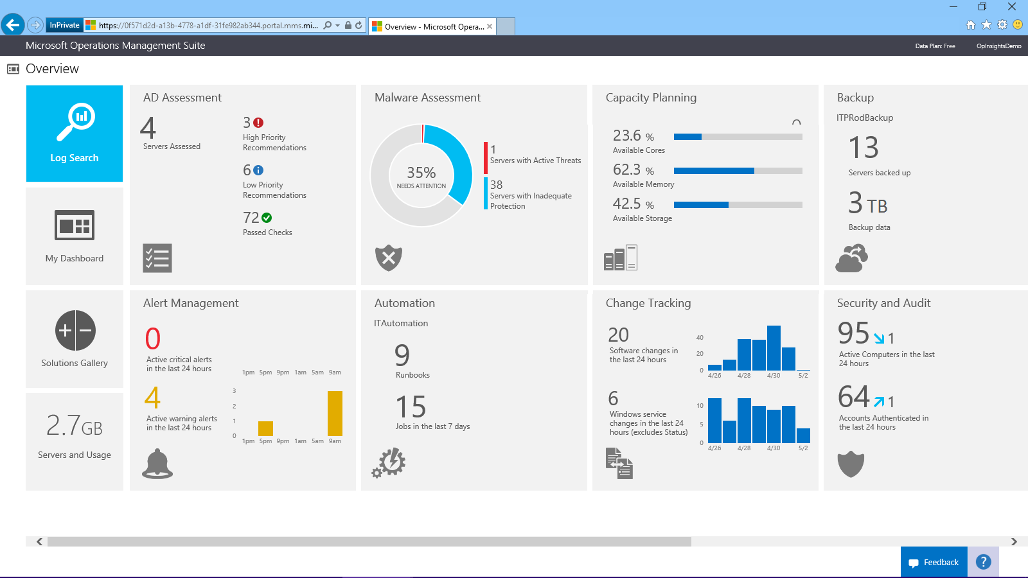

Slide 5
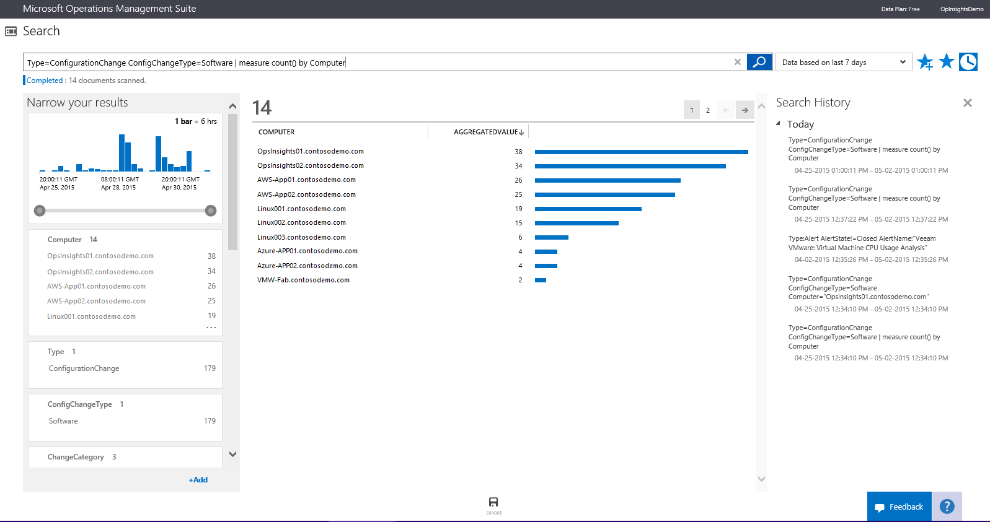
Integrated search
Combine and correlate any machine data from multiple sources
Query, and filter the results by using facet controls.
Automated data visualization
Metrics pivoted around a particular problem areas
Common search queries

Slide 6
Collect, store, and analyze log data
Efficient tracking of server configuration changes
Ad-hoc root cause analysis and automated troubleshooting
Custom graphical saved searches for more insight with dashboards
Change tracking across multiple data sources
Powerful search capabilities to drill deeper into areas of interest
Rich dashboard and reporting capabilities powered by search queries
Notes:
Change tracking across multiple data sources
Know what has changed on your servers
Easily identify operational issues caused by Windows services and software changes
Identify anomalies in the software deployment schedule
Powerful search capabilities to drill deeper into areas of interest
Quickly receive interactive results
Form your own hypotheses and query data to find custom insights
Enable proactive exploration or reactive troubleshooting
Rich dashboard and reporting capabilities powered by search queries
Set custom visualization and thresholds
Get more insight by drilling down through search tiles
View your entire infrastructure with a single lens

Slide 7
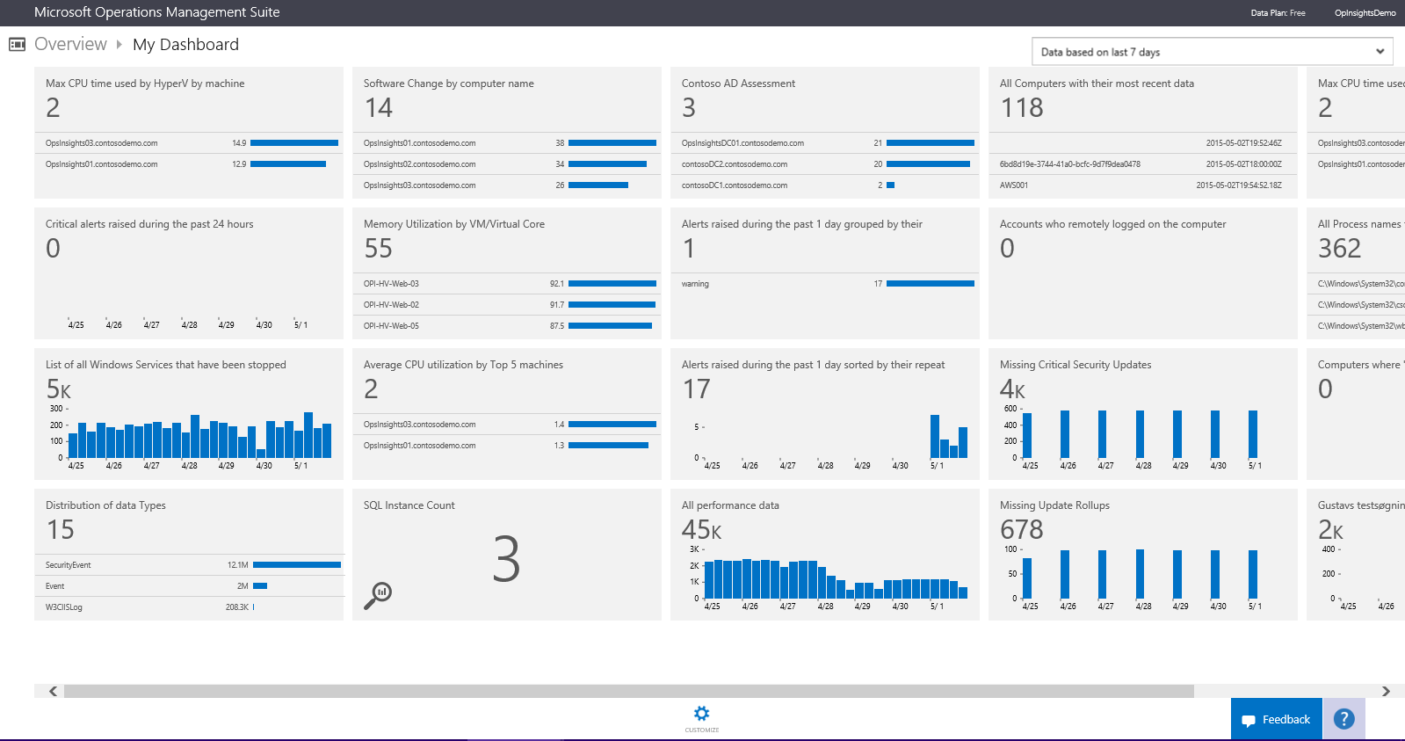
Custom Dashboard
Visualize all of your saved searches, providing a single lens to all your environment.
Custom or sample searches
Customizable visual information
Shareable across teams

Slide 8
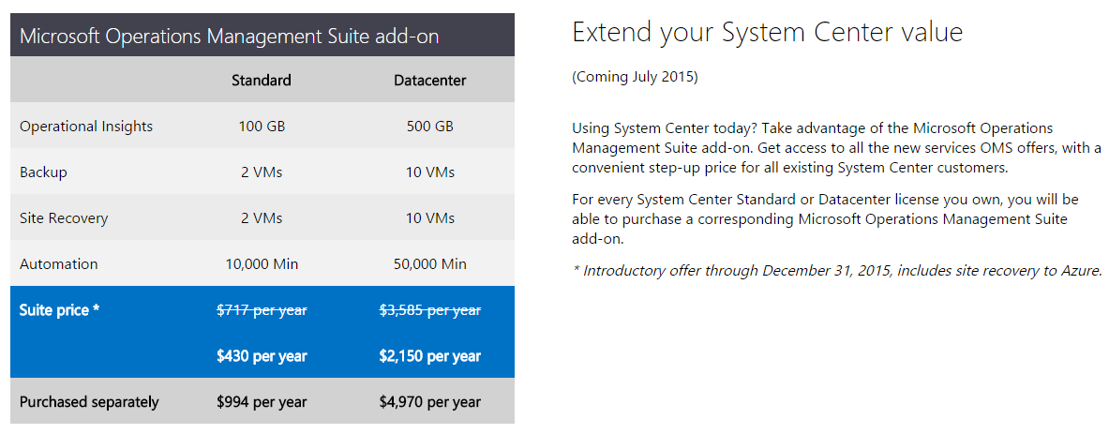
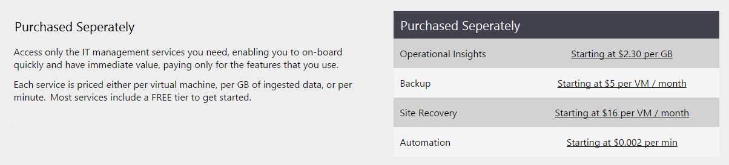
Pricing and licensing

Slide 9

Operations Management Suite Roadmap
Containers
Analytics | Automation | Recovery >>
Configuration
Wire data
Configuration management database
Linux
Inventory
Operations
Management Suite
Patching
Alerting
Remote operating system management
Security | Update | Change | Dashboards >>

Slide 10
© 2015 Microsoft Corporation. All rights reserved. Microsoft, Windows, Windows Vista and other product names are or may be registered trademarks and/or trademarks in the U.S. and/or other countries.
The information herein is for informational purposes only and represents the current view of Microsoft Corporation as of the date of this presentation. Because Microsoft must respond to changing market conditions, it should not be interpreted to be a commitment on the part of Microsoft, and Microsoft cannot guarantee the accuracy of any information provided after the date of this presentation.
MICROSOFT MAKES NO WARRANTIES, EXPRESS, IMPLIED OR STATUTORY, AS TO THE INFORMATION IN THIS PRESENTATION.

